Slide 1
設計電力の制約
2025.2

Slide 2


目的
この章では、次の項目を学習します。
目的 01
設計電力の制約とは何か
目的 02
推奨される消費電力制約の特定
目的 03
消費電力制約アドバイザー ツールの使用
目的 04
電源レール制約の特定

Slide 3
設計電力の制約
電力の制約
XDC ファイルを介して合成および P&R ツールにガイダンスを提供する
ツールは、次の条件を満たす最適なソリューションを検索するようとする
  位置
  タイミング
  電力ガイダンス
説明
環境状況
  周辺温度
  Theta JA
  ジャンクション温度
  シリコン プロセス タイプ
  その他の用語
消費電力の目標–デザインの消費電力バジェット
Notes:
Let’s first understand what design power constraints are. Like other types of constraints, power constraints provide guidance to the synthesis and place and route tools via the XDC file. Based on these constraints, the tools will attempt to find the best solution that meets location, timing, and power guidance simultaneously.
Power constraints are a class or group of constraints that describe the physical operating environment and target conditions. Included in this group are constraints that describe the ambient temperature in which the device will be running, the “theta JA” (which is the rate at which heat can be moved between the silicon and the environment), the maximum junction temperature, the silicon process type, and other terms. Not all terms are required, but the more specific the designer is, the more likely that the design is to work.
One of the most critical terms is the total design power budget. The tools contain a power estimator, which is more thoroughly described in the Designing with the Versal Adaptive SoC: Power and Board Design course.

Slide 4


Vivado Design Suite での消費電力制約
Vivado™ Design Suite は、タイミングと消費電力の両方の制約を満たすのに役立つ
Vivado Design Suite
プロジェクト
電力の制約
ツールは、タイミングと電力要件の両方を満たそうとする
Notes:
The Vivado Design Suite can help designers meet both timing and power constraints.
When an XDC file containing power constraints is added to the project, the tools will make every effort to simultaneously meet both timing and power requirements.

Slide 5

Vivado Design Suite での消費電力制約
XDC コマンド
set_operating_conditions
環境および物理パラメーターを定義
例
  set_operating_conditions –ambient_temp 50; # 摂氏
  set_operating_conditions –thetaja 3; # 消費電力予測ツールから取得された、熱の移動速度
  set_operating_conditions –design_power_budget 20; # ワット単位
Notes:
The set_operating_conditions XDC command enables users to enter environmental and physical parameters, such as voltage, production grade, ambient temperature, airflow, and many other qualities.
The first example here tells the tools that the operating environment is 50ºC. The cooler the operating environment, the more heat can be dumped to it faster.
The next example describes the theta for the junction-to-ambient value. This value describes the rate at which heat can be moved out of the silicon and into the environment. This value is often determined using the Power Estimator spreadsheet tool for the family of parts you are using. Heat sinks, forced air cooling, and other factors are considered by this tool to provide an accurate value.
Finally, the design power budget is the maximum power that the device is allowed to draw. If the tool’s estimate exceeds this value, then the run will fail.

Slide 6
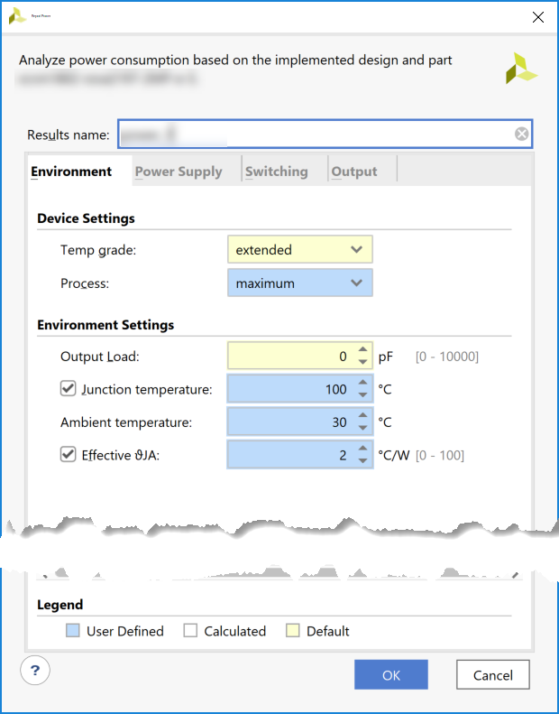
Vivado Design Suite での消費電力制約
Vivado™ Design Suite は、タイミングと消費電力の両方の制約を満たすのに役立つ
消費電力解析に反映される制約
Notes:
These power constraints are reflected in the power analysis view where the constrained values are highlighted in blue, and the not-yet-constrained values remain with a white background.
As with all constraints, it is important to not over-constrain a design. These parameters should be available in the design specification from your system architect.
It’s one thing to slightly tighten a constraint to account for a future upgrade or a worst-case situation; however, tightening a constraint too much is almost guaranteed to result in a failed run.

Slide 7
推奨される消費電力制約
消費電力バジェットが定義されていることを確認する
最大プロセスを設定する
熱情報がない場合、最大ジャンクション温度 (Tj) を使用する
set_operating_conditions -design_power_budget <Power in Watts>
set_operating_conditions -process maximum
set_operating_conditions -junction_temp <Max Tj Based on Temp Grade>
Notes:
To ensure design closure, correct power constraints should be applied. Let’s look at some of the recommended power constraints.
The first recommended power constraint is to specify the design power budget in Watts. This allows report_power to indicate if the power is over or under the budget. Also, the engineer running design closure may not be involved in the power or thermal decisions, so it allows them to understand if the design is passing or not.
Next, in order to ensure that worst-case static is reported, the maximum process must be set.
The final constraint listed here ensures that a worst-case junction temperature is taken. This is not the optimal constraint to apply but, in the absence of thermal information, it allows you to estimate the worst-case power for the design, and, until you know the thermal capability of the application, you must assume worst case. So here we are setting the junction temperature to the maximum allowed for the temperature grade. For industrial, this would be 100ºC and, for commercial, it would be 85ºC.

Slide 8
最高精度の消費電力制約
熱データなし: ワースト ケースの消費電力解析
消費電力の見積もりをさらに改良することができる
  アプリケーションが動作する最大周囲温度とその熱ソリューションの効率 (theta JA) を指定する
  ボードおよびアプリケーションに依存する値
製品の現実的な見積もりを取得するには、次の手順を実行する:
  アプリケーションがサポートする最大周囲温度を定義する
    set_operating_conditions -ambient_temp <Max Supported by Application>
  theta JA の定義 - 熱ソリューション効率 (C/W)
    set_operating_conditions -thetaja <Increase in Tj for Every W Dissipated C/W>
  例: 消費 W ごとに 1.5 C/W、Tj は 1.5C 増加する
Notes:
In the last slide, in the absence of thermal data we forced the junction to the maximum temperature. While not ideal, this at least gives a worst-case number; however, this can be easily refined by specifying the maximum ambient temperature that the application will operate in and the efficiency of its thermal solution (or theta JA).
These values are completely board and application dependent, and you must specify these to get a realistic estimate for your own product.
The ambient temperature is simple enough. It is the maximum supported ambient temperature that the application will support. For example, in wireless, this can be 50ºC. In an automotive application, this can be as high as 85ºC, whereas in consumer, it can be lower. This all depends on the application and end market.
The theta JA simply describes the thermal solution efficiency. It should be obtained from a thermal simulation, and it describes how effective heat is being pulled away from the device. It is specified as degrees per watt and shows how much the junction temperature will increase for every watt of power dissipated in the device.
For example, 1.5ºC/W would mean that, for a 10W design, the junction temperature will increase by 15ºC. Coupled with an accurate ambient temperature, this allows you to estimate the junction temperature.
If you have 40-degree ambient and a 10W design, the junction temperature will be approximately 55ºC. You can then accurately report the static power at 55ºC and you know the dynamic power will not change with the temperature. So now, you are getting a much more accurate power number.

Slide 9
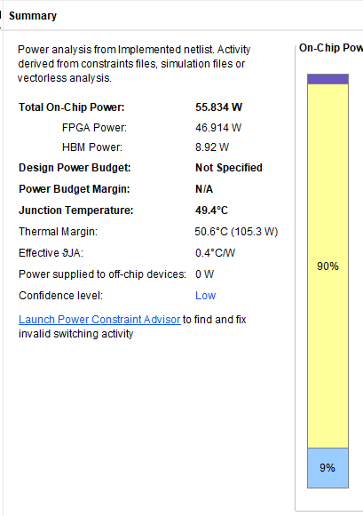
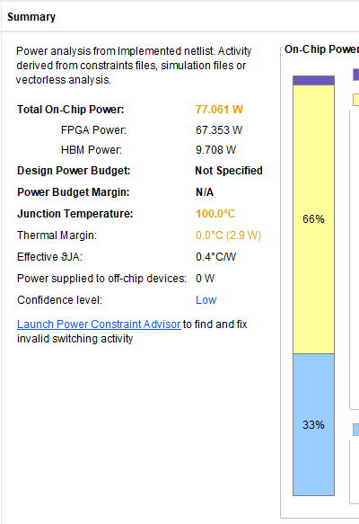
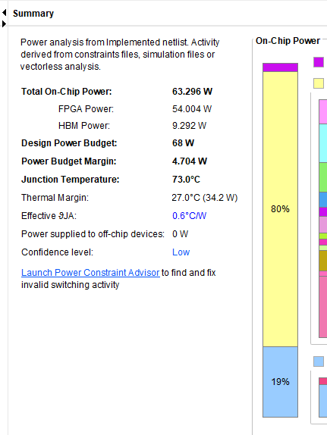
Ta と ƟJa を使用した消費電力見積もりの洗練
制約なし – 55W
ワースト ケース – 77W
最大プロセスと Tj 最大
改善 – 63W
Ta 最大 - 35ºC & Ɵja – 0.6 C/W
スタティック消費電力と総電力の正確なモデリングを保証する
Notes:
Let’s now look at the impact of the design budget, maximum process, ambient temperature, and lastly theta ja constraints on the total design power with the help of an example.
Consider a design as a data center 75W card, and it is using an UltraScale+™ HBM device. Let's go through the typical user flow. This is the report_power run with no power constraints defined in the design, so let's start with that step first.
Here you can see that the power estimate is 55W when no constraints are applied on a 75W card—which is a good initial number. However, let’s look at the result in more detail. We can see that there is no power budget defined. As this is the default setting, you know that an ambient of 25º and Typical process have been used. As you learned earlier, this does not give a worst-case power analysis because it does not correctly model the static power contribution.
So, to be more realistic, we must look at the maximum process numbers and, until we have the thermal parameters from a thermal simulation, we must assume the worst case. In this case, the industrial-grade device has a junction temperature of 100º.
Now things look a little different. We have gone from 55W and thinking everything is ok to 77W on a 75W card, so we immediately know that we need to investigate further. We can see that if the design operates at the thermal limits, it will be too high power for this application.
At this point, more information is needed on the specifics of the board. For example, what is the maximum power budget for the FPGA itself and what are the thermal characteristics? By that, we mean what is the maximum ambient temperature that the application needs to support and what is the theta JA for the thermal solution?
Later, you find out the power budget from your boards team to be 68W (with 7W is allowed for other components, such as memory and regulator losses on the card) and a theta JA is 0.6º /Watt. So, for every Watt of power, the junction temperature will increase by 0.6ºC. The maximum inlet temperature allowed is 35ºC, so that is our ambient temperature.
Now, either using the report_power GUI or using the constraints commands, you can apply these new constraints.
Let’s say with these constraints, we are now at 63W. We can see that there is a 4.7W margin based on the power budget given, so we can see that we are in a better position than before.
This illustrates how some relatively simple constraints can cause such a large change in design power. Remember that we went from a totally unrealistic 55W with the default settings to 77W—a 40% increase. Then by refining the analysis with realistic ambient and thermal solution values, we came down to a much more accurate and realistic total power number of 63W. This is the impact that static power can have on power analysis.
The static impact can be easily seen in these report_power results. You can clearly see it went from 9% to 33% and then back to 19% when the junction temperature was accurately modelled. The dynamic power of the power contribution from the actual design in the FPGA stayed constant for all of these estimates—the only change was static.
This example shows the importance of refining your power analysis with the maximum ambient, maximum process, and the theta JA of your thermal solution.

Slide 10
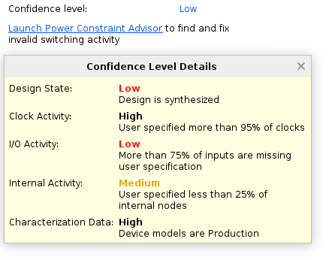
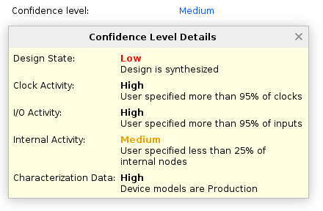
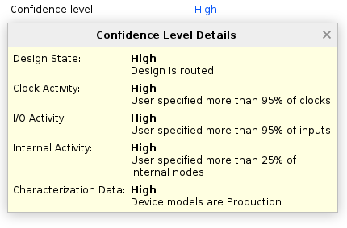
信頼性レベルの改善
高い信頼性レベルの精度を達成しようとする - 消費電力レポートを確認する
  スイッチング アクティビティの制約を確認する: 不足している制約を指定し、無効な制約を修正する
  正確な信号消費電力を実現するために、インプリメンテーション後に消費電力をレポートする
  最新の消費電力特性評価データを得るには、最新の Vivado™ Design Suite バージョンを使用する
Low:
配線されていない設計
消費電力制約なし
Medium:
配線されていない設計
いくつかの消費電力制約
High:
配線済みデザイン
優れた消費電力制限
Notes:
We have covered the static contribution to design power. Now let's take a look at the dynamic portion.
You may have noticed in the previous slide that the confidence level was Low. This is what we will examine next.
You should always aim for a High confidence level when running report_power. A simple way to achieve this is to:
Review the switching activity constraints and ensure that they are complete and accurate
Run report_power after implementation to get accurate placement and trace length information
And have the latest version of the Vivado Design Suite installed for the most up-to-date models
The confidence level is displayed in the report_power Summary tab as seen here.
A general tip when navigating report_power is that any text shown in this blue color means that there is additional information available if you click it. In this case, clicking it brings up the confidence level details.
The confidence level, while it is displayed as a single value, is made up of five factors, so you should be aiming to have a High confidence for all five to ensure the most accurate power analysis.
When you do achieve a High confidence level power analysis, the report_power value is expected to be more accurate than the same estimate in XPE since the Vivado Design Suite has key information (such as trace lengths that impact capacitance)—allowing report_power to have a 5% higher accuracy than XPE for the same design and characterization level.
Let's look at the confidence level details.
Design state: This is simply the state of the design if report_power is run on a synthesized design. The placement details are missing and so the trace lengths are unknown. Obviously, the best point to run a power analysis is after the design has been successfully placed and routed.
Clock Activity: Again, this shows the parallels between timing closure and power closure. The report_power vectorless engine uses the clock constraints to estimate the toggle rates of nets, so this is one of the confidence indicators. If a compete timing analysis is also being run in parallel, in order to get an accurate timing or power result, this value should be 95% or above.
I/O Activity: One of the more commonly overlooked areas, this again allows the vectorless engine to more accurately estimate the switching in your design. You are the best person to understand how the I/Os will behave in terms of signal transitions and toggle rates. Unless told otherwise, report_power assumes a static probability of 0.5 and a toggle rate of 12.5%, so where possible and to ensure a more accurate estimation, an I/O activity of 95% or more should be applied.
Internal Activity: This covers the internal nodes of the design. The most important are the sets, resets, and enables. These should all be correctly set. For example, if the starting state for an enable is low, then report_power would analyze that logic for low to no toggle rates—underestimating its power. However, in designs where there might be operations that are mutually exclusive (for instance, you may only transmit or receive but not at the same time), then having the transmit and receive data paths active at the same time would overestimate power in that case. So, it is critical to ensure that the set, reset, and enables are all correctly defined for the worst-case analysis. We will look at this in more detail in the next slide.
Characterization Data: The last piece that contributes to the confidence level is the characterization level. We have four characterization levels. New device families will start at Preview at +-30%, then move on to Advanced at +-25%, Preliminary at +-20%, and finally Production at +-15%. For Versal™ AI Core and Prime series, we are currently at Preliminary, and so that is +-20%.
It’s clear that the accuracy of the power analysis is related to the confidence level. To be able to trust the analysis, you should aim for the highest confidence level.

Slide 11
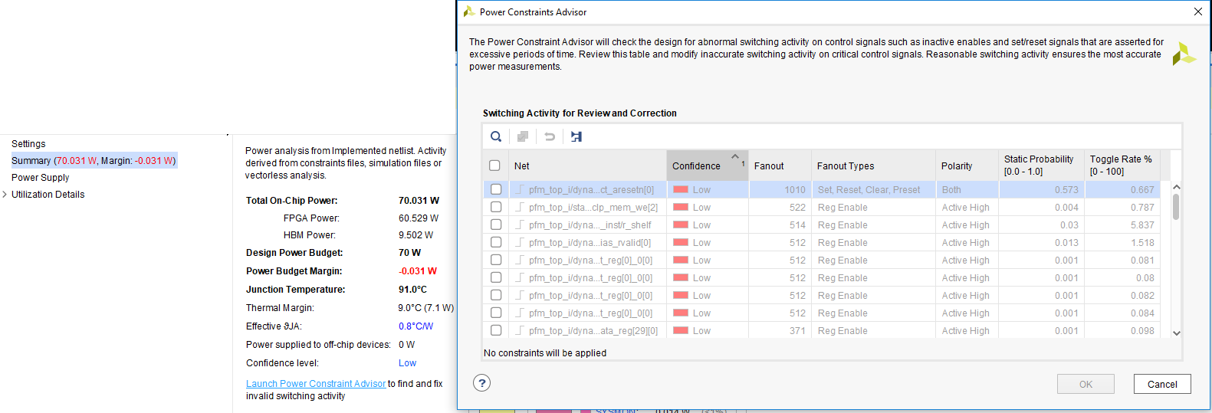
消費電力制約アドバイザー
[Power Summary] の [Power Constraints Advisor] の起動から利用可能
セット、リセット、有効化の信頼性レベルを示すシンプルな GUI
  ソートとフィルタリング
  信頼性の低い、高いファンアウト ネットから始める
負の消費電力マージンが明確に示される
Notes:
When it comes to internal activity, we do have a useful tool called the Power Constraints Advisor, which can be launched from the report_power summary.
It is a simple GUI showing the net names, confidence levels, fanouts, fanout types, and polarities, as well as the static probabilities and toggle rates that are currently applied.
It allows for easy sorting and filtering of Low confidence high fanout nets. You can enable or disable them based on their polarities—allowing for the logic power to be correctly reported.
The Power Constraints Advisor from report_power gives you greater visibility into how the design is being constrained internally.
report_power also indicates if the design power budget has been exceeded—in which case, a negative power margin is displayed.
In this example, with a less efficient thermal solution, you can see that total power is just over the 70W budget, and it is highlighted in red with a negative margin.

Slide 12
電源レーン制約
Vivado™ Design Suite の新機能
デザインの消費電力バジェットおよびその他の熱パラメーターと合わせて使用する
レギュレータの電源を検証できるようにする
一部のレギュレータが仕様不足である場合に役立つ
新規電源レールを作成する:
create_power_rail <power rail name> -power_sources {supply1, supply2 ,..}
既存の電源レールに電源ソースを追加する:
  add_to_power_rail <power rail name> -power_sources {supply1, supply2, ..}
電流バジェットの定義:
  set_operating_conditions -supply_current_budget {<supply rail name> <current budget in Amp>} -voltage {<supply rail name> <voltage>}
Notes:
A new feature in the Vivado Design Suite called power rail constraints supports board-level regulator constraining.
These constraints should be used along with the correct design power budget as well as the thermal parameters we have discussed previously.
These new constraints now enable report_power to validate not just the design power budget but also the specific rails on the board.
This feature is useful in scenarios where your design is within your total power budget, but you have under-specified some of the regulators.
There are three constraints required. You can simply create the rail and give it a name that is relevant to your board schematic and then assign which device rails are connected to it. You can then specify the total current as well as the voltage of the regulator.
The constraints are:
create_power_rail, which creates a rail and connects the supplies to it
add_to_power_rail, which lets you add additional supplies as needed and
set_operating_conditions, which has the supply_current_budget and voltage switches to specify the current and voltage of the rail.

Slide 13
電源レーン制約 - 例
直接: 1 つのレギュレータを 1 つ以上のレールに接続
0.85v @55A レギュレータ
Virtex™ UltraScale+™ FPGA
create_power_rail board_85V -power_sources {VCCINT VCCBRAM VCCINT_IO}
set_operating_conditions -supply_current_budget {board_85V 55} –voltage {board_85V 0.85}
55A
VCCINT
VCCBRAM
VCCINT_IO
間接: 2 つ以上のレギュレータ ステージ
複数の規制ステージを定義可能
  例: ボードの電源とレール電流
set_operating_conditions -supply_current_budget {VCCINT 50 VCCBRAM 1 VCCINT_IO 4}
Virtex UltraScale+ FPGA
0.85v
@ 50A
VCCINT
5v
@ 47W
0.85v
@ 1A
VCCBRAM
0.85v
@ 4A
VCCINT_IO
Notes:
Let’s have a look at two examples. The direct rail is a single 55A 0.85V regulator connected to the VCCINT, VCCBRAM, and VCCINT_IO of a device. This is a direct connection to the device and is simply specified using the constraint shown here.
The create_power_rail command is followed by the schematic name (in this case, board_85V) and the connected rails (VCCINT, VCCBRAM, and VCCINT_IO). The set_operating_conditions command is then used to specify the current and voltage.
For an indirect rail, you can include both the FPGA regulators as well as the board supply. For a simple example, we have a 5V 47W supply, which equates to 55A @ 0.85V (as in the first example), but now we have regulators for each FPGA rail, 50A for VCCINT, 1A for VCCBRAM, and 4A for VCCINT_IO.
To build on the above constraints, you can use the set_operating_conditions command and supply the current budget again to specify the current for each rail so that report_power can check not only the FPGA regulators but the board supply as well.

Slide 14
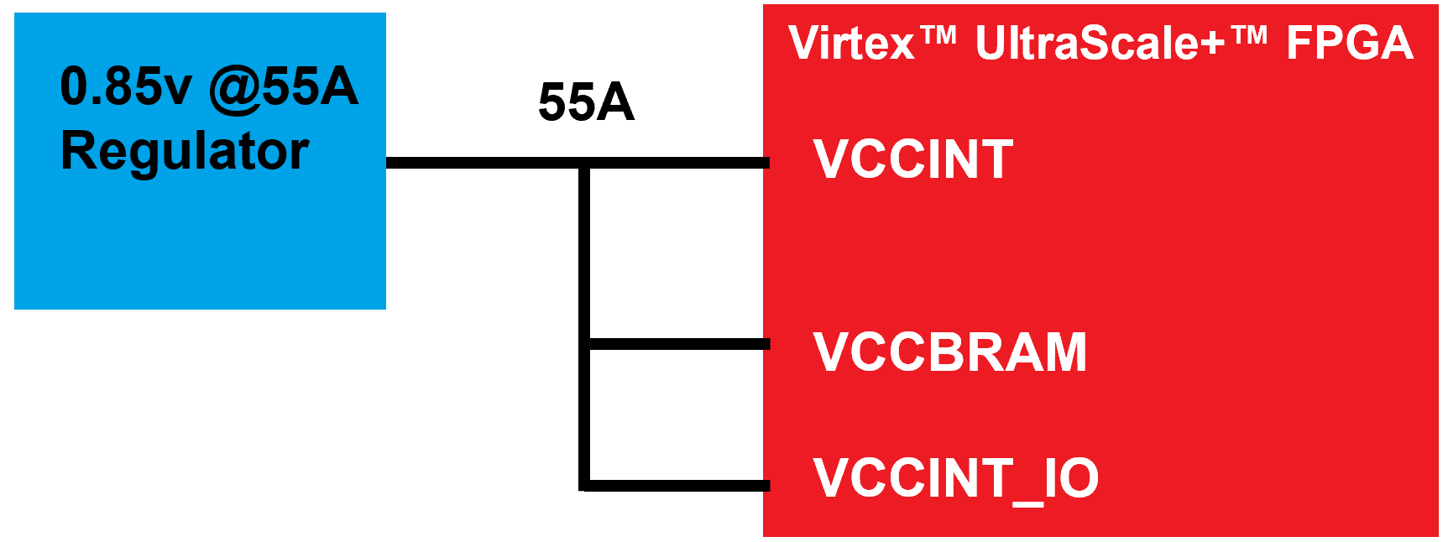
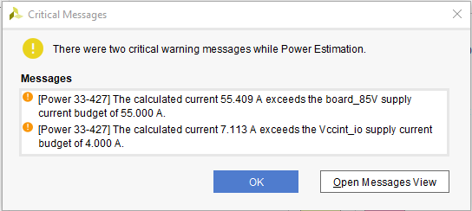
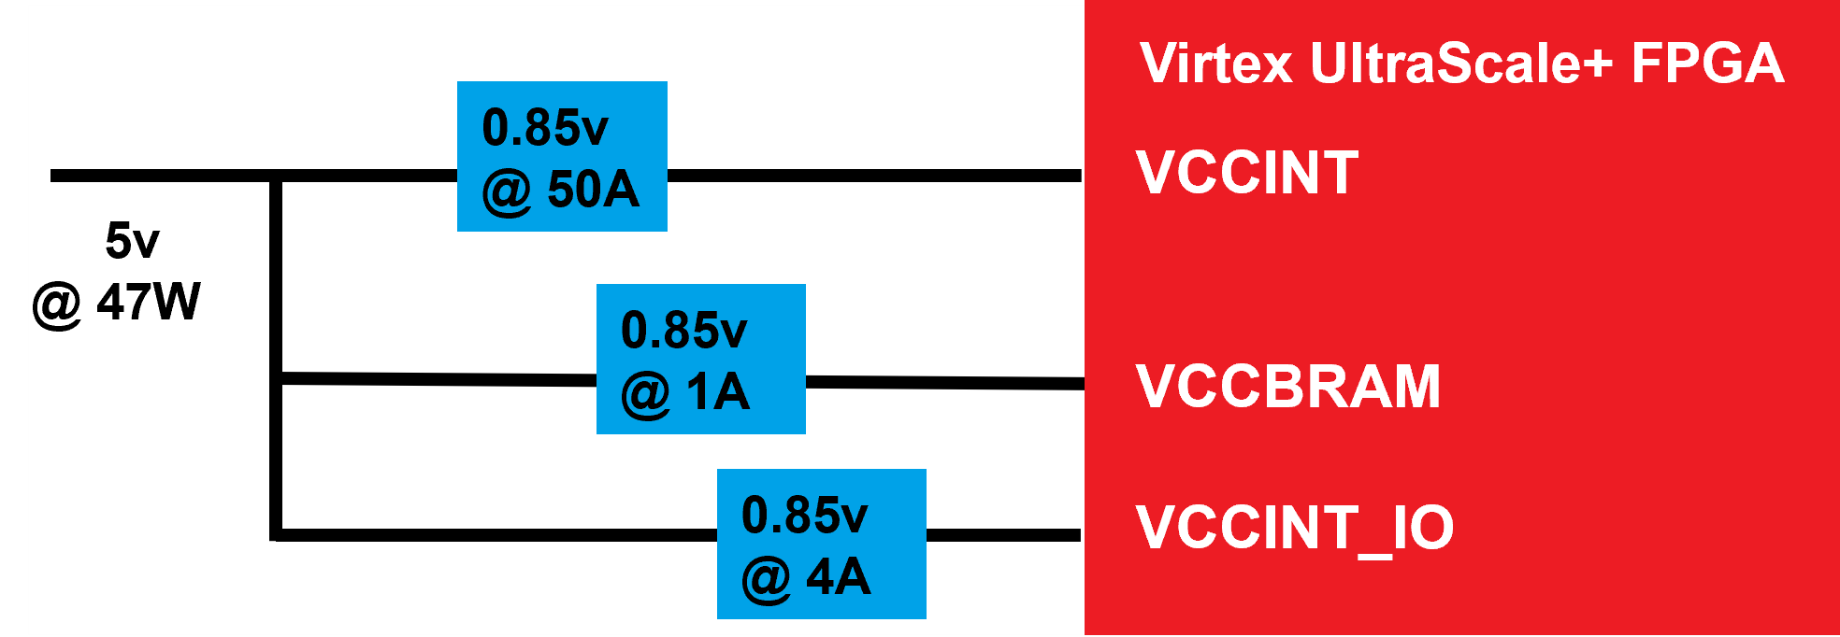
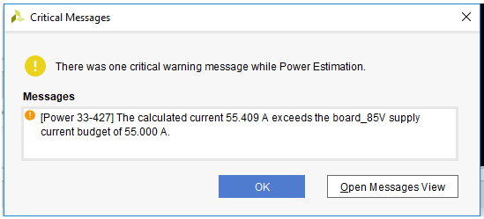
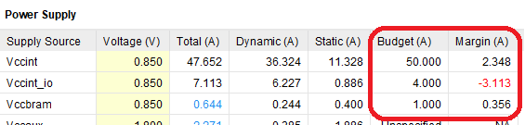
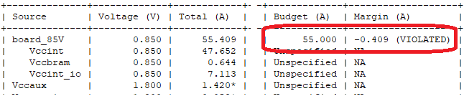
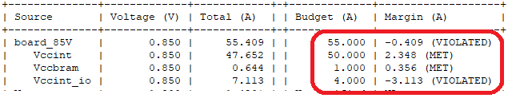
電源レーン制約 - 結果
1 つ以上のレールに対する 1 つのレギュレータ
2 つ以上のレギュレータ ステージ
クリティカル警告が生成される:
テキスト レポートでレポートされるマージン
Notes:
So, let's take a look at the results of the two examples.
In the direct or single regulator to one or more FPGA rails example, we can see that a critical warning is generated in the text report, showing that we have exceeded the 55A based on the report power analysis. In addition, the VCCINT, VCCBRAM, and VCCINT_IO rails are all combined here under the board_85V rail.
Note that the direct approach is only supported via the text report and not in the report_power GUI. This will be added to a future version of the Vivado™ Design Suite.
For the two or more regulator stages example, we can see a critical warning for both the main supply as well as VCCINT_IO since it exceeds its 4A budget.
With these additional constraints in report_power, you can not only check the total power for your design but also specify the power delivery requirements as well. This means that you can have confidence that when you program your board there will not be a power, thermal, or even a power delivery issue if the design has been correctly constrained.

Slide 15

確認問題
set_operating_conditions XDC コマンドを使用すると、__________ などの
環境パラメーターと物理パラメーターを入力できます。
電圧
周囲温度
エアフロー
上記のすべてが正しい
Notes:
Correct answer:
All of the above
Correct feedback:
You selected the correct answer.
Incorrect feedback:
The set_operating_conditions XDC command enables you to enter environmental and physical parameters, which include voltage, production grade, ambient temperature, airflow, and many other qualities.
Try again feedback:
Hint: Review the “Power Constraints in the Vivado™ Design Suite” slide.

Slide 16
確認問題
__________によって、report_power で高い信頼レベルの精度を実現できます。
スイッチング アクティビティ制約の確認
不足している制約の指定と無効な制約の修正
最新の Vivado™ Design Suite バージョンを使用し、最新の電力特性データの取得
上記のすべてが正しい
Notes:
Correct answer:
All of the above
Correct feedback:
You selected the correct answer.
Incorrect feedback:
All of the options are correct.
Try again feedback:
Hint: Review the “Power Constraints Advisor” slide.

Slide 17
まとめ
01
消費電力制約は、物理的な動作環境およびターゲット条件を記述する制約のクラスまたはグループ
周辺温度
Theta JA
ジャンクション温度
プロセス タイプ
その他の用語
02
デザイン クロージャを達成するには、正しい消費電力制約を適用する必要がある
03
消費電力制約アドバイザーは、デザインに適用されているセット、リセット、イネーブル信号の信頼性レベルを表示するシンプルな GUI ツール
04
電源レールの制約により、report_power はデザインの消費電力バジェットだけでなく、ボード上の特定のレールも検証可能

Slide 18
GENERAL DISCLOSURE AND ATTRIBUTION STATEMENT
The information contained herein is for informational purposes only and is subject to change without notice.While every precaution has been taken in the preparation of this material, it may contain technical inaccuracies, omissions and typographical errors, and AMD is under no obligation to update or otherwise correct this information.Advanced Micro Devices, Inc. makes no representations or warranties with respect to the accuracy or completeness of the contents of this material, and assumes no liability of any kind, including the implied warranties of noninfringement, merchantability or fitness for particularpurposes, with respect to the operation or use of AMD hardware, software or other products described herein.No license, including implied or arising by estoppel, to any intellectual property rights is granted by this document.Terms and limitations applicable to the purchase or use of AMD’s products are as set forth in a signed agreement between the parties or in AMD's Standard Terms and Conditions of Sale.GD-18.
©2023 Advanced Micro Devices, Inc. All rights reserved. AMD, the AMD Arrow logo, UltraScale+, Virtex, Vivado, and combinations thereof are trademarks of Advanced Micro Devices, Inc. Other product names used in this publication are for identification purposes only and may be trademarks of their respective owners.

